Slide 1
Improvements to Classification Indexes
Narasimham Arava, narasimhamarava@gmail.com
Luigi Vanfretti, luigi.vanfretti@gmail.com

Slide 2
Outline
Goals of the presentation
Requirements
Proposed Methods
Improved Indexes
Post-fault Overload Index
Post-fault Under-/Over-Voltage Index
Voltage stability index

Slide 3
Goals of the presentation
To provide a summary of the new indices.

Slide 4
Requirements
Overload index and Over/Under voltage index :
To check whether the operational limit of the transmission lines has been breached.
To check whether steady state is reached.
Voltage stability index :
Previously developed index requires three simulations at slightly different operating conditions, to give a good estimate of the voltage index.
But the simulation can only run one time continuously.

Slide 5
Proposed Methods-Overload Index
Operational Limit Check:
To find the over load, the maximum value of each line is compared to its mean value at the end of the simulation.
A global overload index will be computed, in similar way than before (see fx in deliverable) but the difference in this method is that the Smax,i will be taken from the platform directly.
The detailed information about the lines which breached limits (less than or equal to 1, bigger than 1 and much bigger than 1) is given in a matrix.

Slide 6
Proposed Methods-Overload Index
Steady state check:
The stability of the simulated line active power is determined by comparing mean of slope computed from time windows.
The computation will give similar results as an output, where less than or equal 1 is steady state, and much bigger than one is not steady state.
The computation approach above, will be carried out for each line, and stored in an individual line index gi.

Slide 7
Proposed Methods-Over/Under voltage Index
Because of the requirements for Overload and Over/Under voltage indices are same, the same computation approach used in overload index is proposed with the following differences.
Over-voltage limit: Previously, this value was taken as the average of the initial set of points in the simulation.
It will be replaced to use an over-voltage limit provided by the iTesla toolbox for each line/bus;
otherwise, 5% pu outside the nominal voltage is assumed.
Under-voltage limit: Similar to the above point, a value of the under-voltage limit provided by the iTesla toolbox for each line/bus,
otherwise, we will assume 5% pu outside the nominal voltage.
Final indexes will be organized in the same way as the overload index.

Slide 8
Proposed Methods-Voltage stability Index
Post-contingency index values:
The new method requires to run the simulation for a longer time, and load increments need to be applied sequentially in a given pattern (e.g. add 5 MW every 5 seconds).
This must be done in the load closest to the "pilot" bus or buses (chosen for monitoring the index).
Depending on how many of these "load increments" are allowed (either by you, or by the system response) better accuracy is expected, the more "load increments", the better the estimate.
Ideally, simulation continues until the load increments create a collapse, then a PV curve and index estimates that are certainly "more accurate" than one with less number of load increments.
A minimum of 3 load increments is required.

Slide 9
Proposed Methods-Voltage stability Index
Pre-contingency index values:
Because there is very limited information about the pre-contingency, the voltage limits set at each bus, and the MVA limits set at the selected lines are chosen to give a range of most likely solutions.
The output has two sets of matrices with indices calculated w.r.t pre-contingency curve-1 and pre-contingency curve-2.
More details are given in the following slides.

Slide 10
Improved Indexes
Following a dynamic simulation for a specific contingency, we will use the output data to calculate a set of severity indexes. These should indicate the severity of the contingency.
The indexes will indicate:
If the system will converge to a safe and stable equilibrium point.
To indicate the severity of the instability/stability for each type instability mechanism
Static concerns |  | Dynamic concerns
1. Post-fault overloads of lines | 2. Post-fault bus over- or under-voltages | 3. Voltage stability

Slide 11
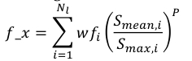
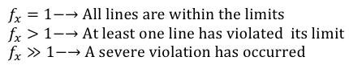
1. Post-fault Overload Index - Theory
Indicate if the post-fault line flows exceed the network capacity by observing the power flows through the transmission lines after an outage occurs.
Number of transmission lines
to be analyzed
Weighting factor
i.e. wfk=[1,1,…,1] for a uniform weight
P is an exponent to reduce masking effects, which means higher the value of the exponent will scale the effects of an overloading resulting in higher index value.
Mean post-fault flow trough transmission line i (from dynamic simulation)
Capacity of transmission line i (from network data)
The final value of the overload index f_x is a scalar and its interpretation is as follows.

Slide 12
1. Post-fault Overload Index-Output
The final outputs are the following,
f_x is the final overload index of the given system.
‘F’ is a matrix, which gives the Level of loading of each line as per the index calculation.
F=[F₁ F₂ F₃….F_{n}] where if Fn >>1 indicates that the operational limit is violated.
‘f’ is a matrix, which gives a list of lines, which violated the operational limit.
‘G’ is a matrix, which indicates the lines that have not reached the steady state
G=[G₁ G₂ G₃….G_{n}] where if Gn >>1 indicates the lines that have not reached steady state.
‘g’ is the matrix, which gives a list of lines that are yet to reach steady state.

Slide 13
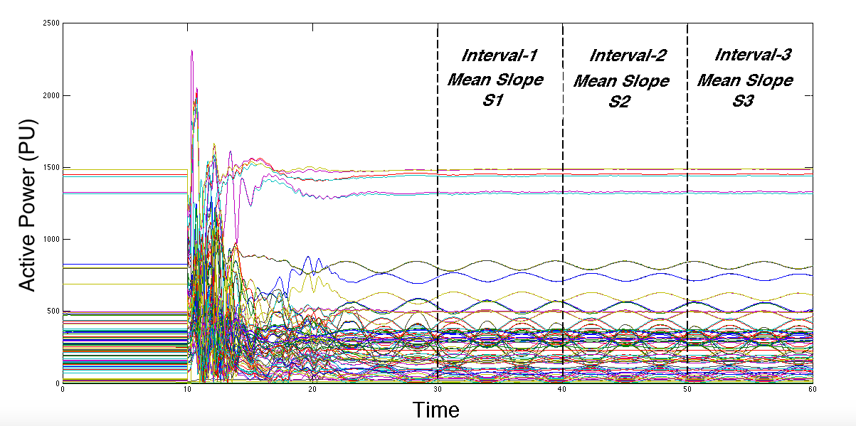
1. Post-fault Overload Index-Simulation Results

Slide 14
1. Post-fault Overload Index-Simulation Results
f_x = 1.2874
‘F’=
Line No. | Index value
1 | 1.2075
2 | 1.2029
3 | 1.4362
. | .
59 | 0.8952
. | .
117 | 1.1969
118 | 0.9619
‘f’=
Line No. | Index value
1 | 1.2075
2 | 1.2029
. | .
27 | 1.0235
. | .
110 | 1.1153
117 | 1.1969

Slide 15
1. Post-fault Overload Index-Simulation Results
‘G’=
Line No. | Index value
1 | 2.7742
2 | 3.0121
3 | 0.0173
. | .
59 | 0.4723
. | .
117 | 0.7262
118 | 0.5280
‘g’=
Line No. | Index value
1 | 2.7742
2 | 3.0121
. | .
27 | 6.0285
. | .
71 | 3.5384
72 | 3.6912

Slide 16
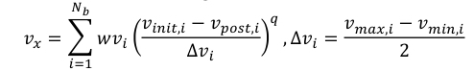
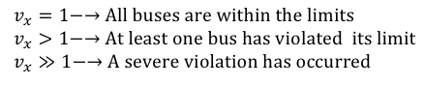
2. Post-fault Under-/Over Voltage Index-Theory
Indicates whether or not the bus voltages deviations exceed those acceptable to the TSO, by observing the voltage across the transmission network after a contingency has occurred.
Pre-fault bus voltage magnitudes (from dynamic simulation)
Mean of post-fault bus voltage magnitudes
(from network data)
P is an exponent to reduce masking effects
Weighting factor
i.e. wvk=[1,1,…,1] for a uniform weight
Number of buses to be analyzed
Maximum acceptable voltage deviation (from the network data). vmax,i and vmin,i are the upper and lower voltage limits for the ith bus
The final value of the overload index Vx is a scalar and its interpretation is as follows.

Slide 17
2. Post-fault Under-/Over Voltage Index –Output
The final outputs are the following,
v_x is the final Under/Over voltage index of the given system.
‘F’ is a matrix, which gives the voltage level of each bus as per the index calculation.
F=[F₁;F₂;F₃…;F_{n}] where if Fn >>1 indicates that the operational limit is violated.
‘f’ is a matrix, which gives the list of buses that violated operational voltage limit.
‘G’ is a matrix, which indicates the bus voltages that have not reached the steady state.
G=[G₁;G₂;G₃…;G_{n}] where if Gn >>1 indicates that the buses has not reached steady state.
‘g’ is a matrix, which gives list of the buses, which are yet to reach steady state.

Slide 18
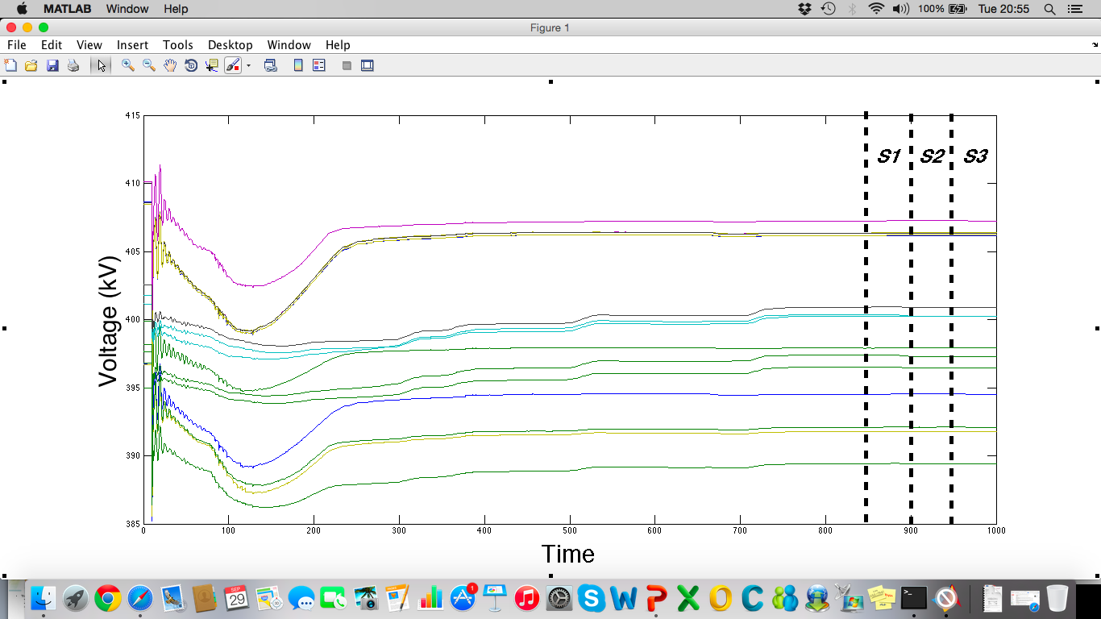
2. Post-fault Under-/Over Voltage Index -Simulation Results

Slide 19
1. Post-fault Overloads Index-Simulation Results
v_x = 1.2856
‘F’=
Bus No. | Index value
1 | 1.000
2 | 1.000
3 | 1.000
. | .
13 | 1.2446
. | .
36 | 1.1922
37 | 1.1922
‘f’=
Bus No.
20
21
.
27
.
36
37

Slide 20
1. Post-fault Overloads Index-Simulation Results
‘G’=
Bus No. | Index value
1 | 0.0002
2 | 0.0002
3 | 0.0001
. | .
13 | 0.0007
. | .
36 | 0.0004
37 | 0.0004
‘g’=
Bus No. | Index value
- | -

Slide 21
3. Voltage stability index-Theory
The three layers of index are
Single Bus Index (SBI)
All Bus Index (ABI)
Global Bus Index (GBI)
The GBI is a 2-element vector that provides the overall minimum distance to the power and voltage limits.
GBI
The ABI is a (1X6) vector that provides the minimum distance among the each loading level to the power and voltage limits, in pre and post contingency.
ABI
The SBI is a (NbX6) matrix, which provides the distance in pre and post contingency for each loading level to the Power (Plim) and voltage (Vlim) limits of the selected bus or group of buses. ‘Nb’ is Number of selected buses
Column 1-3 correspond to the distance for each loading level to the limit with respect to power while column 4-6 corresponds to the distance for each loading level to the limit with respect to the voltage.
First row refers to the pre-contingency data while second row refers to post-contingency data.
If an element of SBI is negative, then the power or voltage of some loading level has exceeded the operational limits.
SBI

Slide 22
3. Voltage stability index-Post-contingency
The new method requires to run the simulation for a longer time, and the input "load increments” are given sequentially in a pattern (e.g. add 5 MW every 5 seconds).
This must be done in the load closest to the "pilot" bus or buses (chosen for monitoring the index).
Depending on how many of these "load increments" are allowed (either by you, or by the system response), you can get better and better accuracy, the more "load increments", the better the estimate.
A minimum of 3 load increments is required.
Pre
contingency
Post-contingency
P5
P4
P
P3
P1
P2
Time

Slide 23
3. Voltage stability index-Pre-contingency
Because there is very limited information about the pre-contingency,
we would need to use the voltage limits set at each bus, and the MVA limits set at the chosen lines for monitoring
No load operating point of the bus, to give a range of most likely solutions.
Two PV curves are the bounds where a physically valid solution exists.
Operating points based on
voltage and MVA limits
of the lines
Operating point from simulation
No load
operating point
Solution exists between
the two curves
V
P

Slide 24
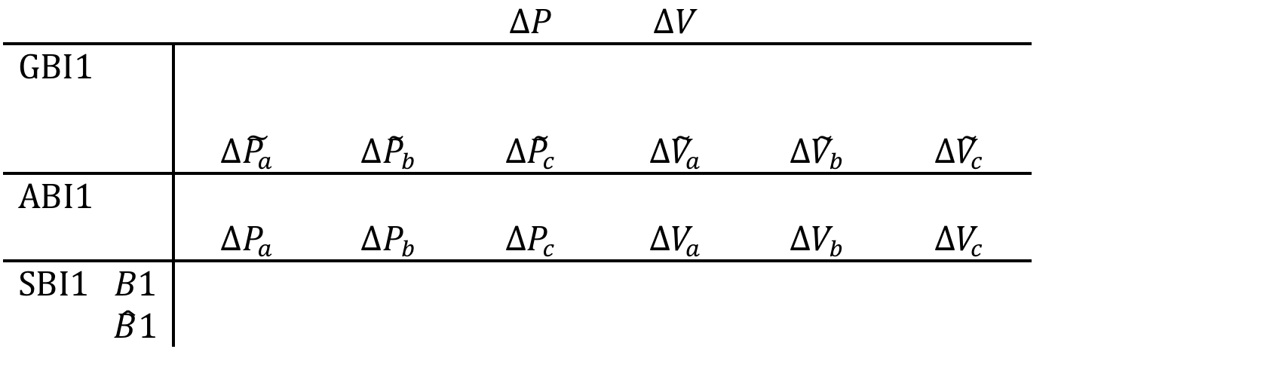
3. Voltage stability index-Output
Voltage stability Indexes will be calculated with respect to Pre-contingency PV curve-1 and PV curve-2.
Post-Contingency w.r.t. Pre-Contingency 1

Slide 25

3. Voltage stability index-Output
Voltage stability Indexes will be calculated with respect to Pre-contingency PV curve-2.
Post-Contingency w.r.t. Pre-Contingency 2

Slide 26
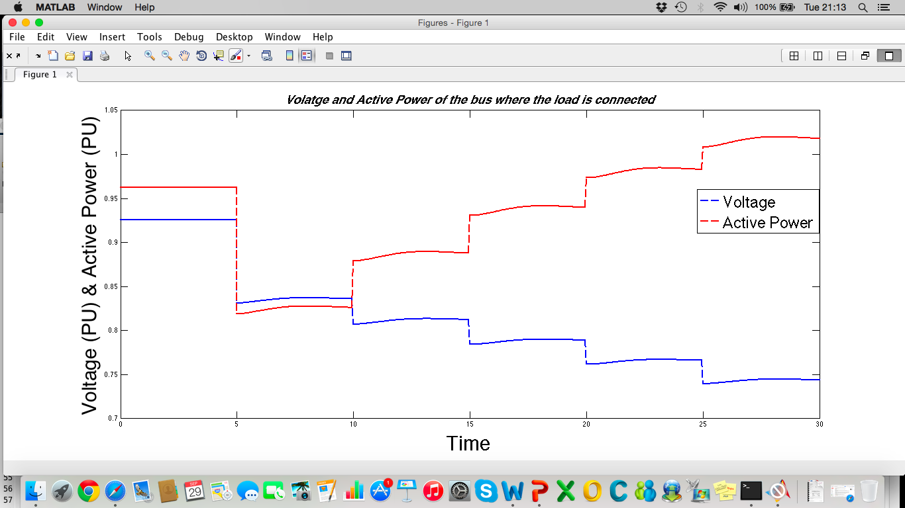
3. Voltage stability index-Simulation Results
(sec)
It can be observed from the plot that contingency is created (outage of one line) at t = 5 sec and load variations are applied sequentially every 5 sec. from t = 10 sec until t_f.
This figures shows how load increments can be applied.

Slide 27
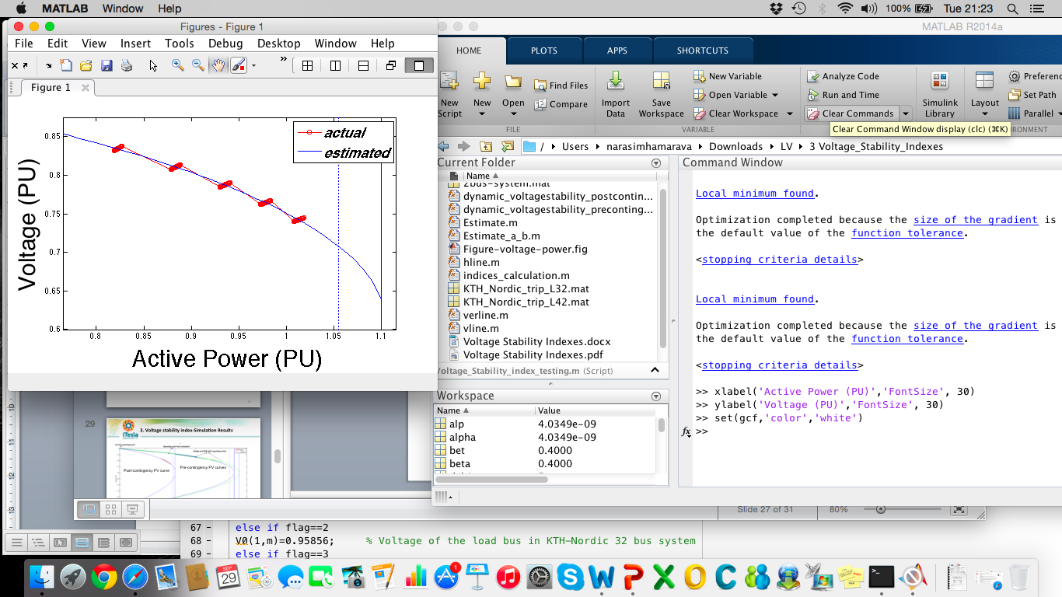
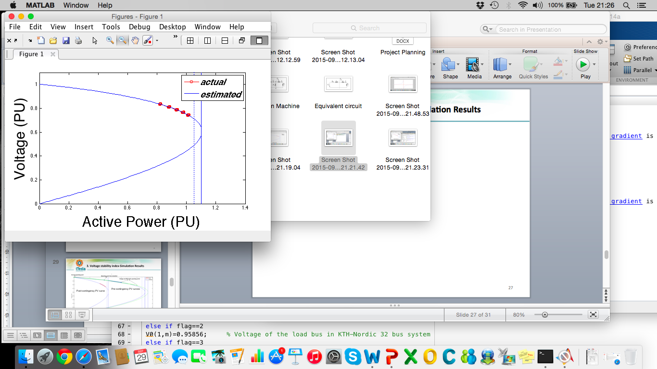

3. Voltage stability index-Simulation Results
Post-contingency PV curve

Slide 28
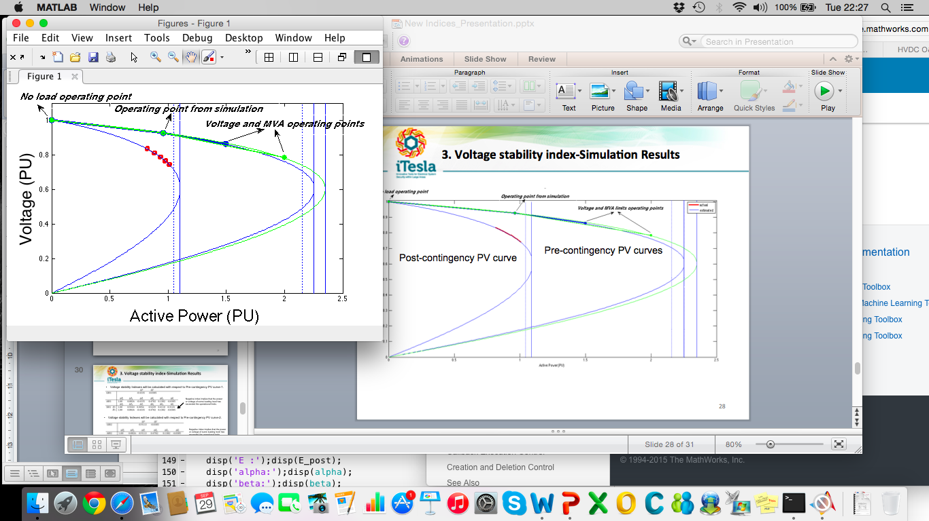
3. Voltage stability index-Simulation Results
Estimated
Actual
Estimated
Actual
Actual
Post-contingency PV curve
Pre-contingency PV curves

Slide 29
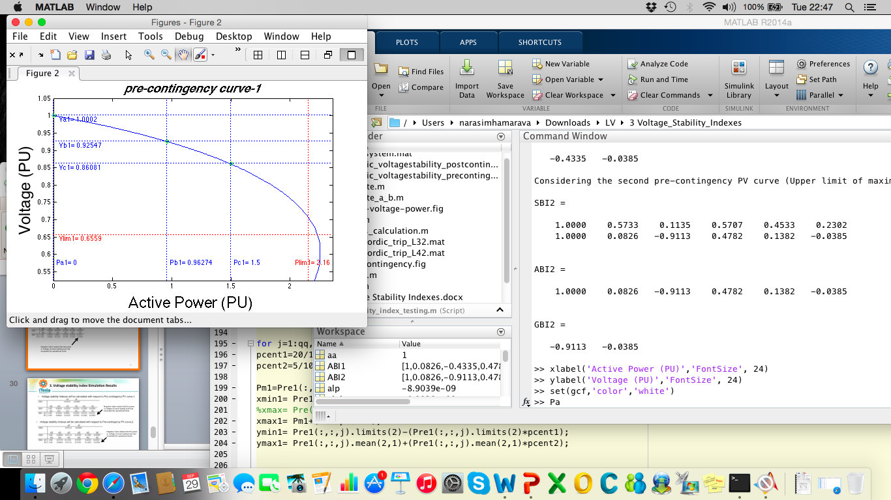
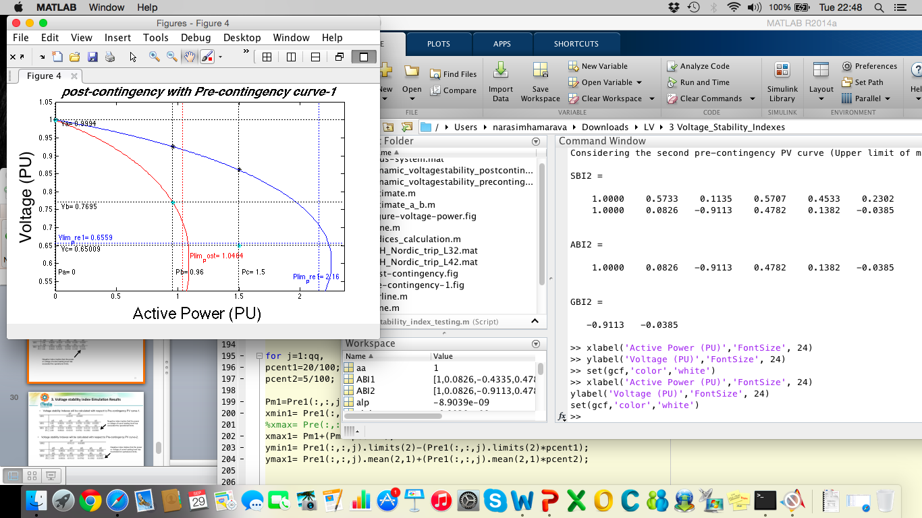
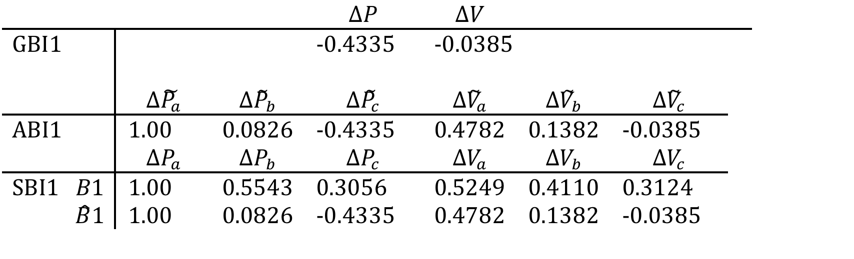
3. Voltage stability index-Simulation Results
Voltage stability Indexes will be calculated
with respect to Pre-contingency PV curve-1.
Negative index implies that the power
or voltage of some loading level has
exceeded the operational limits.
Because the No load operating point is one of the three operating points used to estimate the Pre-contingency curve-1.
Post-contingency
Pre-contingency

Slide 30
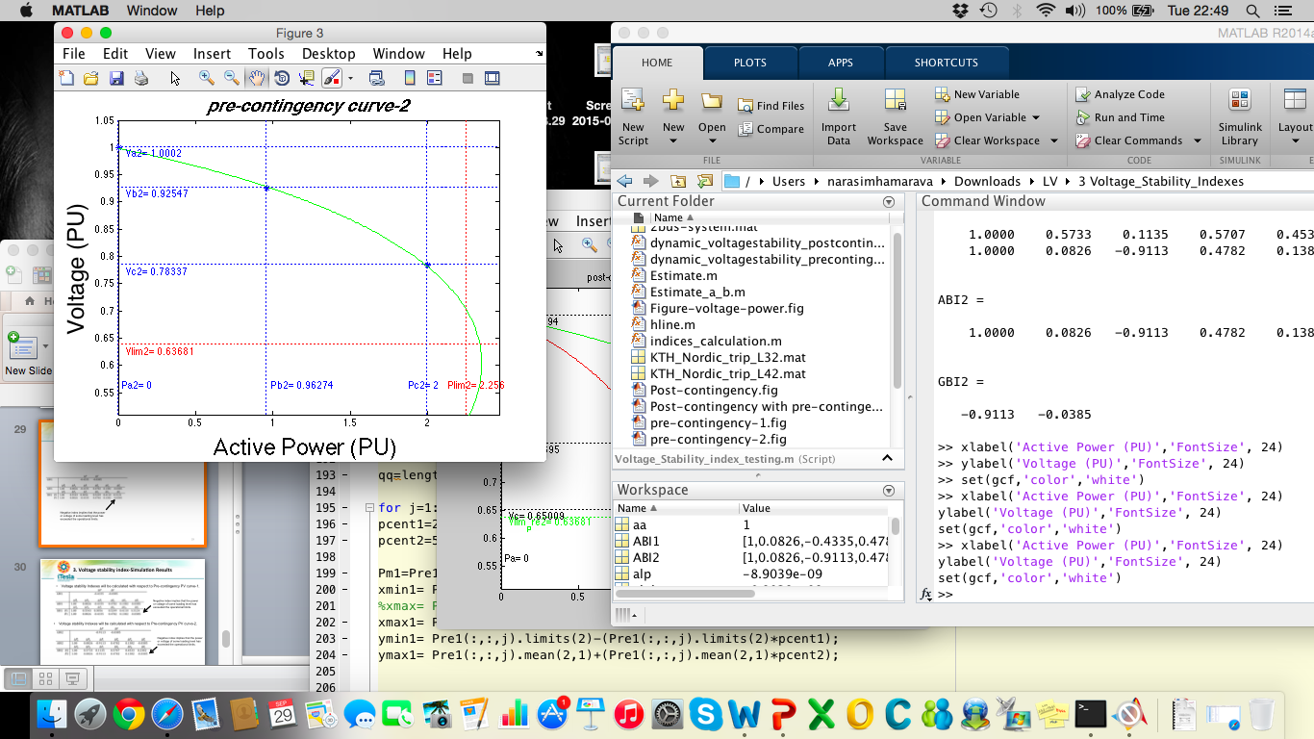
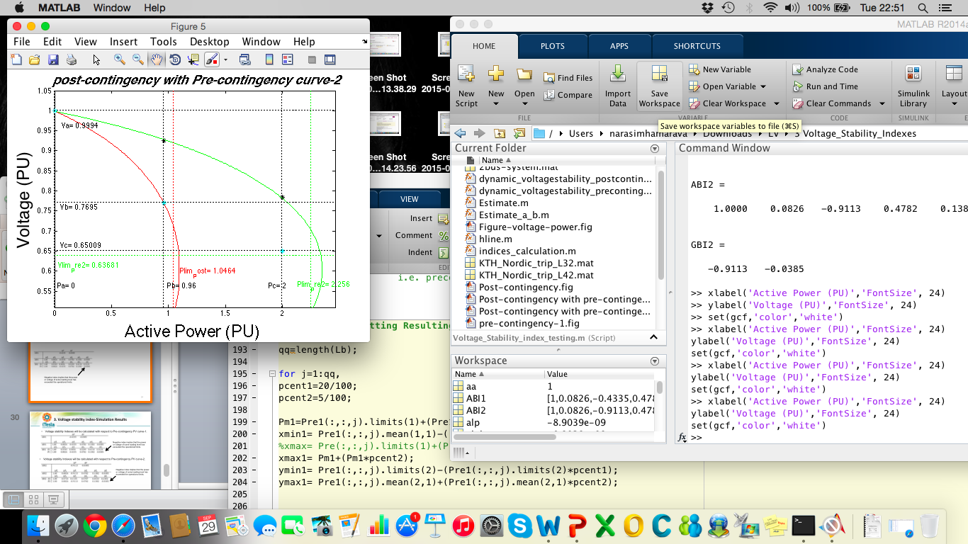
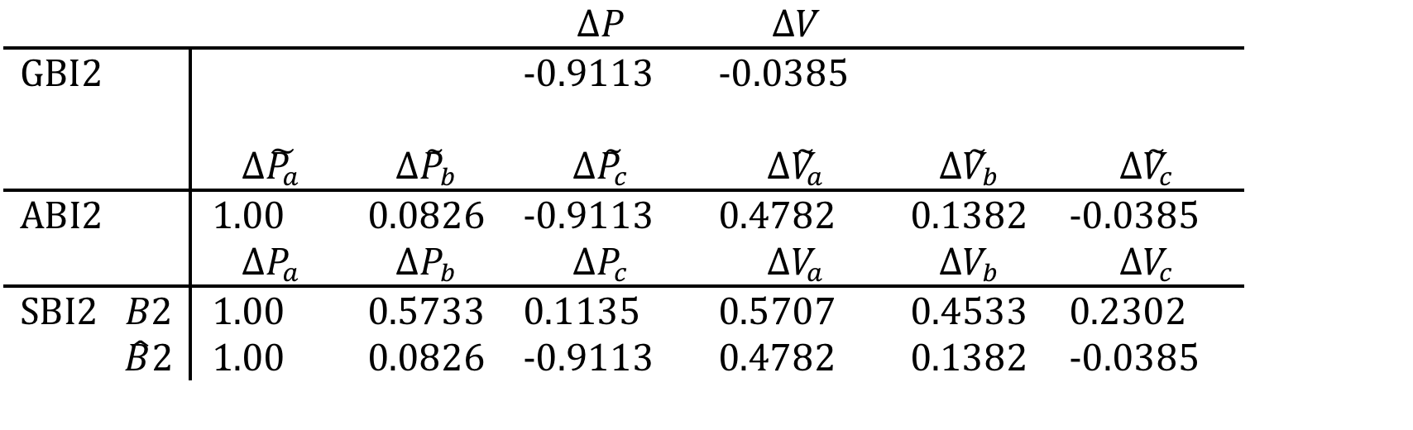
3. Voltage stability index-Simulation Results
Voltage stability Indexes will be calculated
with respect to Pre-contingency PV curve-2.
Negative index implies that the power
or voltage of some loading level has
exceeded the operational limits.
Because the No load operating point is one of the three operating points used to estimate the Pre-contingency curve-2.
Pre-contingency
Post-contingency

Slide 31
Thank You

